Slide 1

Travel & Tourism Management System (TMS)
Final Report | RIPHAH INTERNATIONAL UNIVERSITY
Prepared By: Shahroz Khalid (SAP: 53531), Basit Ali (SAP: 54596)
Supervised By: Mr. Usman
Date: December, 2025

Slide 2

Introduction & Objectives
The TMS aims to streamline and enhance travel planning activities, offering users comprehensive management of personal details, packages, hotels, and additional tools.
1
2
User-Friendly Platform
Efficient Task Management
Create an intuitive and accessible interface for all users.
Organize and manage all travel-related tasks efficiently.

Slide 3

System Overview & Technology
Technology Stack
Language: Java
GUI: Java Swing
Database: MySQL (Relational)
Key Features
Authentication: Secure Login, Sign up, Password Recovery.
Travel Management: View/Book/Manage Packages, Hotels, Destinations, Personal Details.
Tools: Calculator & Notepad.

Slide 4
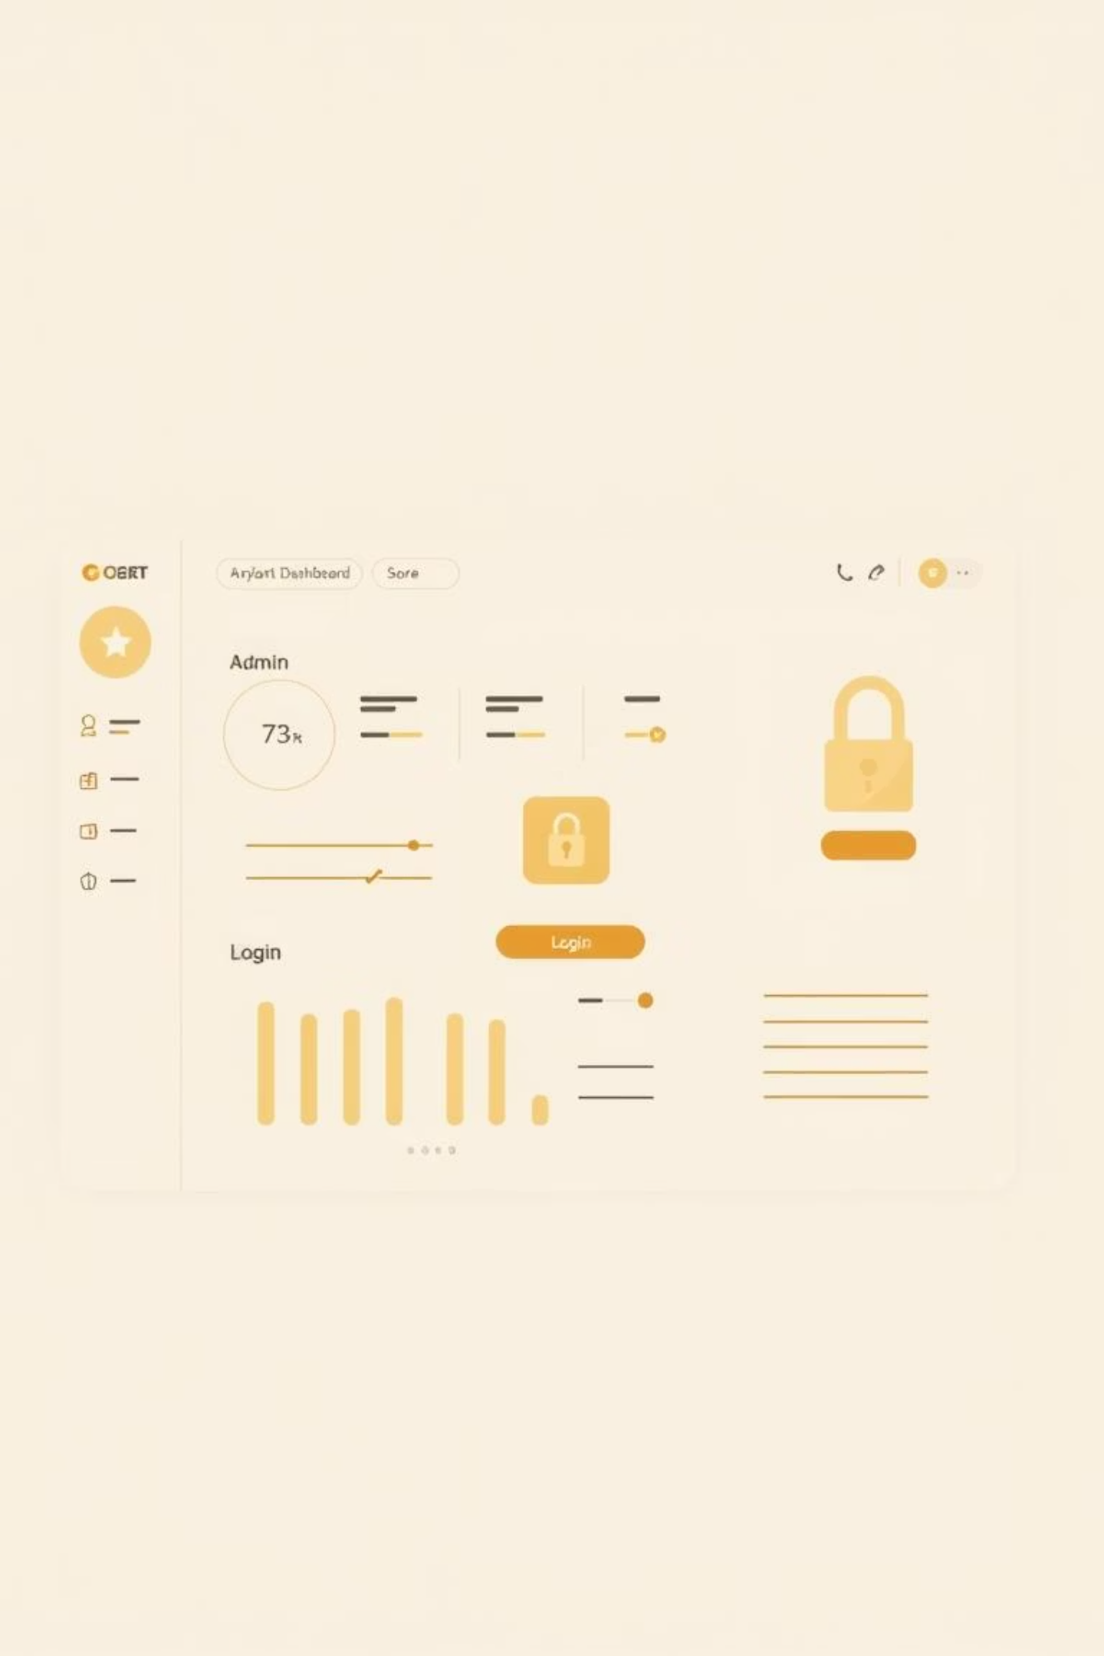



Functional Requirements: Modules
User Module
Dashboard Module
Login/Password Recovery
Travel Packages (View/Book)
Account Creation & Management
Hotel Management (Browse/Book)
Payments & Destinations
Admin Module
Manage Packages
Manage Bookings
Manage Registered Users

Slide 5

System Design & Architecture
Architectural Design
Client-Server Architecture
Client-side: Java Swing GUI
Server-side: Database Management System
Key Modules
Login: Verifies user credentials.
Dashboard: Central hub for all features.
Utility: Provides additional tools (Calculator, Notepad).

Slide 6

Database Schema
The system utilizes a relational database to store and manage all critical information, ensuring data integrity and efficient retrieval.
Users
Stores user credentials, contact information, and personal details.
Packages
Contains details of all available travel packages.
Bookings
Tracks user bookings and their associated details.
Hotels
Information on available hotels, including pricing and amenities.

Slide 7








Non-Functional Requirements
Performance
Security
Response Time: 1-2 seconds. Processing Time: <3 seconds.
Encrypted passwords, secure authentication, input validation.
Scalability
Reliability
Handles 1000 concurrent users effectively.
Annual failure rate less than 1%.

Slide 8



Challenges & Solutions
Database Integration
Challenge: Managing multiple connections efficiently.
Solution: Implemented connection pooling.
UI Responsiveness
Challenge: Ensuring smooth animations/layouts across screen sizes.
Solution: Utilized adaptive scaling for dynamic layouts.

Slide 9

Testing & Results
Testing Methodology
Unit Testing: Module-level checks.
Integration Testing: Module interaction verification.
System Testing: End-to-end use case validation.
Test Case Results
All critical test cases, including Login (Valid/Invalid), Book Package, and View Booked Hotel, passed successfully.

Slide 10
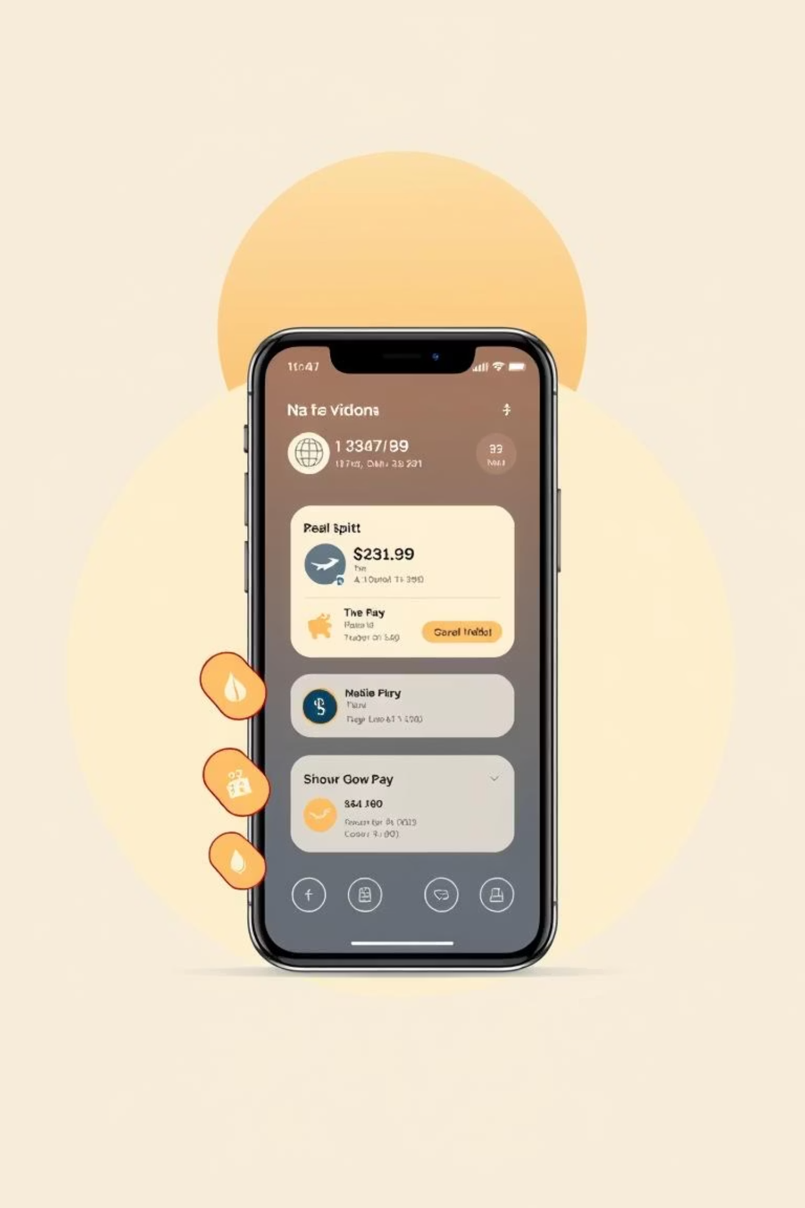

Conclusion & Future Enhancements
The TMS successfully met its objectives, providing a user-friendly, scalable, and secure platform for travel management.
Mobile Application Support
Develop a mobile app for enhanced accessibility.
Real-time Notifications
Implement instant updates for bookings and travel changes.
Payment Gateway Integration
Integrate secure payment gateways for seamless transactions.

